Slide 1
CS 295A/395D: Artificial Intelligence
Reinforcement Learning
Prof. Emma Tosch
29 April 2022

Slide 2
Logistics
Last topical lecture
Exam next Friday
New assignment out later today
Last programming assignment out later today
Monday: Guest lecture (Eric Atkinson) on belief programming
Eric has also worked on programming constructs for sequential decision making
Papers to be linked on the website
Course evaluations

Slide 3
If you do choose to do them, please answer the following:
Did you learn something in this class?
Did you feel respected?
If you liked the class, cool! I’m happy to have not contributed to your misery.
If you didn’t like the class, could you do me a solid and write something like:
While Prof. Tosch’s knowledge of the area is adequate, the course was perhaps a bit too formal. I suspect both she and the students would be much happier if her future course assignments were actually in her active research areas.
I also always enjoy weird commentary:
Overall, Emma Tosch is a new instructor trying to find her way as a UMass graduate at the lax pothead school that is UVM.
I am Prof. or Dr.
Please do not refer to me as Ms. or Mrs.
(yes, I have been called Mrs. in a course eval)

Slide 4
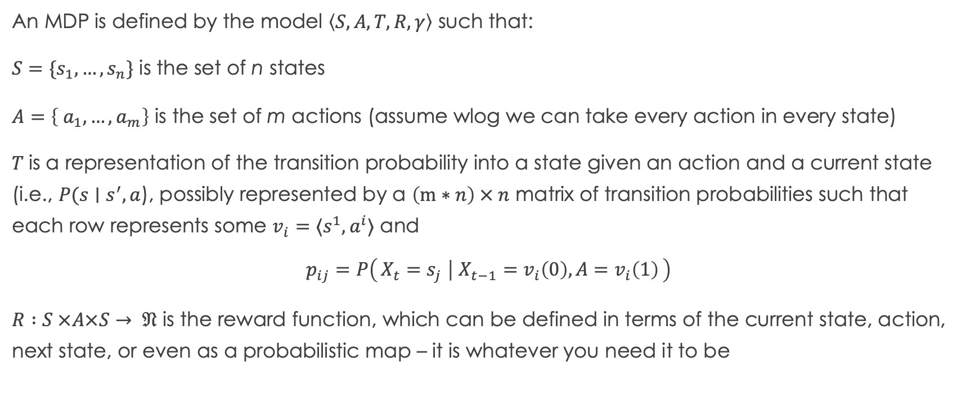
Recall: MDPs
An MDP is defined by the model $\left\langle S, A, T, R, γ\right\rangle$ such that:
$S=\{s_{1},…, s_{n}\}$ is the set of n states
$A=\left\{ a_{1},…, a_{m}\right\}$ is the set of m actions (assume wlog we can take every action in every state)
$T$is a representation of the transition probability into a state given an action and a current state (i.e., $P(s∣s^{′}, a$), possibly represented by a $\left(m∗n\right) × n$ matrix of transition probabilities such that each row represents some $v_{i}=⟨s^{1},a^{i}⟩$ and
$$p_{ij}=P\left(X_{t}=s_{j} ∣ X_{t−1}=v_{i}\left(0\right), A=v_{i}\left(1\right)\right)$$
$R :S ×A×S→ 𝔑$ is the reward function, which can be defined in terms of the current state, action, next state, or even as a probabilistic map – it is whatever you need it to be

Slide 5
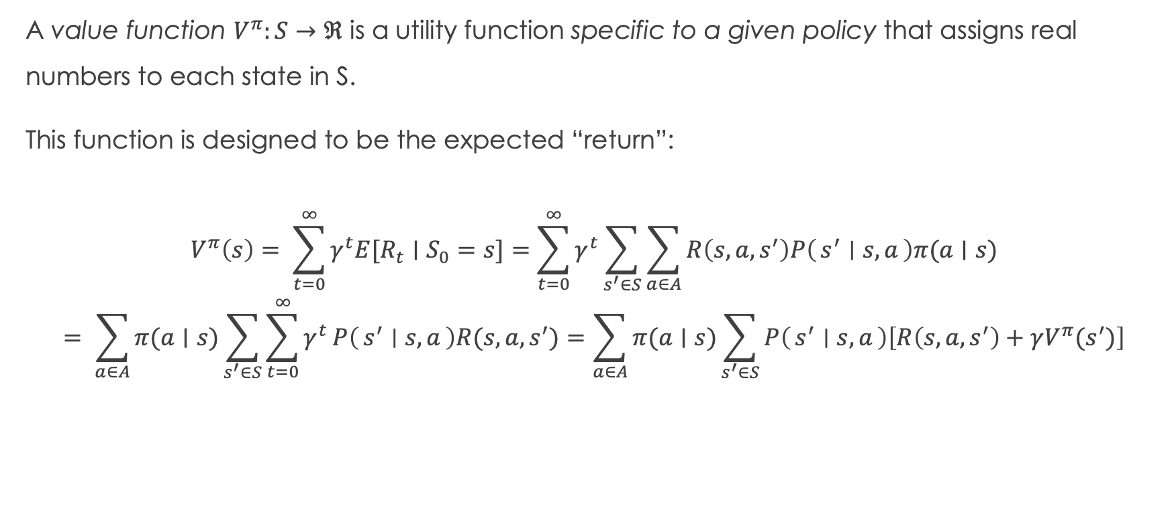
Recall: Value Functions
A value function $V^{π}:S→ℜ$ is a utility function specific to a given policy that assigns real numbers to each state in S.
This function is designed to be the expected “return”:
$$V^{π}\left(s\right)= \sum_{t=0}^{∞}{γ^{t}E[R_{t}}∣S_{0}=s]=\sum_{t=0}^{∞}{γ^{t}\sum_{s^{′}∈S}{\sum_{a∈A}{R\left(s, a, s^{′}\right)P\left(s^{′} ∣ s, a\right)π(a∣s)}}}$$
$$= \sum_{a∈A}{π(a∣s)\sum_{s^{′}∈S}{\sum_{t=0}^{∞}{γ^{t}}P\left(s^{′} ∣ s, a\right)R(s, a, s^{′})}}=\sum_{a∈A}{π(a∣s)\sum_{s^{′}∈S}{P\left(s^{′} ∣ s, a\right)\left[R\left(s, a, s^{′}\right)+γV^{π}(s^{′})\right]}}$$

Slide 6
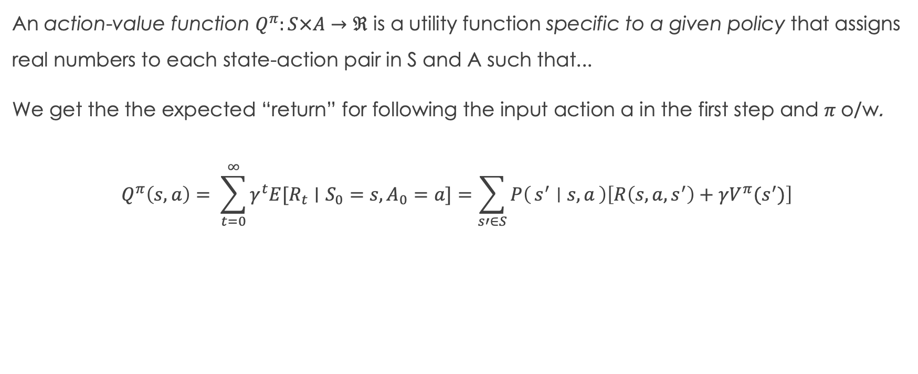
Action-Value Functions
An action-value function $Q^{π}:S×A→ℜ$ is a utility function specific to a given policy that assigns real numbers to each state-action pair in S and A such that...
We get the the expected “return” for following the input action a in the first step and $π$ o/w.
$$Q^{π}\left(s, a\right)= \sum_{t=0}^{∞}{γ^{t}E[R_{t}}∣S_{0}=s, A_{0}=a]=\sum_{s′∈S}{P\left(s^{′} ∣ s, a\right)\left[R\left(s, a, s^{′}\right)+γV^{π}(s^{′})\right]}$$

Slide 7
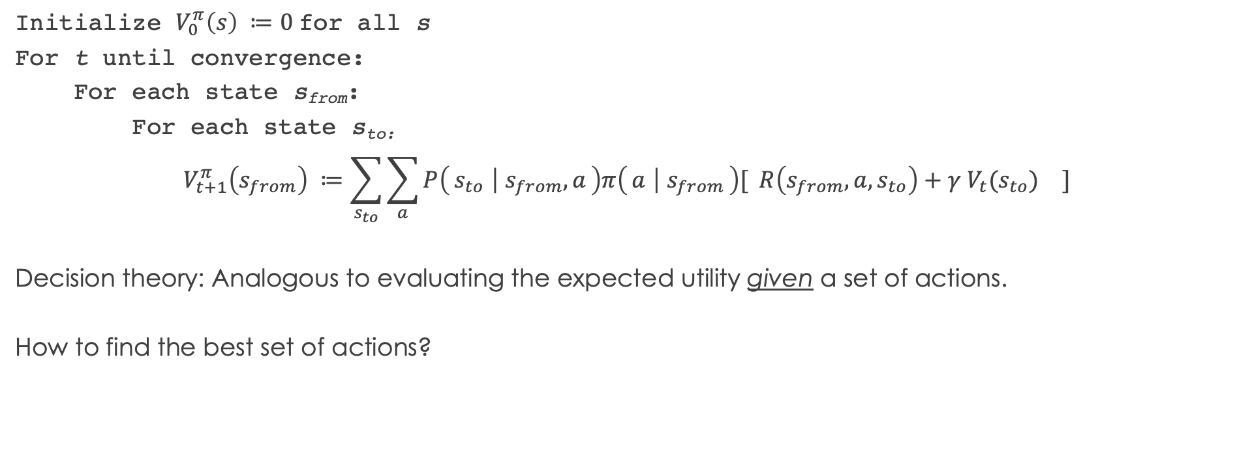
Recall: Computing the value function
Initialize $V_{0}^{π}\left(s\right) ≔0$for all s
For t until convergence:
For each state s_{from}:
For each state s_{to:}
$$V_{t+1}^{π}\left(s_{from}\right) ≔\sum_{s_{to}}{{\sum_{a}{P\left(s_{to} ∣ s_{from}, a\right)π\left(a ∣ s_{from}\right)[ R\left(s_{from}, a, s_{to}\right)+γ V_{t}(s_{to}) }}_{}]}$$
Decision theory: Analogous to evaluating the expected utility given a set of actions.
How to find the best set of actions?

Slide 8
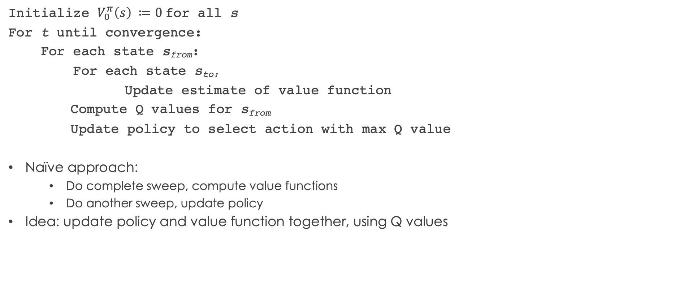
Generalized policy iteration
Initialize $V_{0}^{π}\left(s\right) ≔0$for all s
For t until convergence:
For each state s_{from}:
For each state s_{to:}
Update estimate of value function
Compute Q values for s_{from}
Update policy to select action with max Q value
Naïve approach:
Do complete sweep, compute value functions
Do another sweep, update policy
Idea: update policy and value function together, using Q values

Slide 9
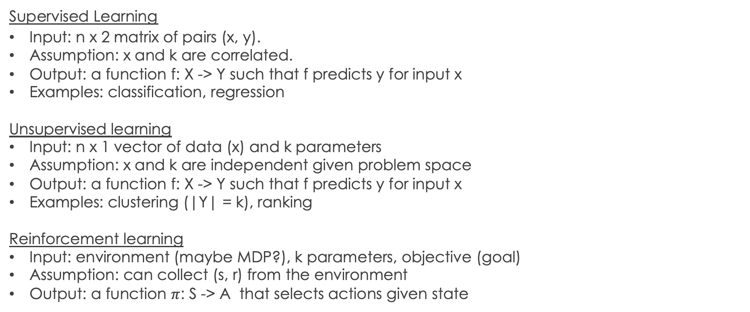
High-level
Supervised Learning
Input: n x 2 matrix of pairs (x, y).
Assumption: x and k are correlated.
Output: a function f: X -> Y such that f predicts y for input x
Examples: classification, regression
Unsupervised learning
Input: n x 1 vector of data (x) and k parameters
Assumption: x and k are independent given problem space
Output: a function f: X -> Y such that f predicts y for input x
Examples: clustering (|Y| = k), ranking
Reinforcement learning
Input: environment (maybe MDP?), k parameters, objective (goal)
Assumption: can collect (s, r) from the environment
Output: a function $π$: S -> A that selects actions given state

Slide 10
High-level
Supervised & Unsupervised Learning are problem-agnostic
Supervised Learning
Input: n x 2 matrix of pairs (x, y).
Assumption: x and k are correlated.
Output: a function f: X -> Y such that f predicts y for input x
Examples: classification, regression
Unsupervised learning
Input: n x 1 vector of data (x) and k parameters
Assumption: x and k are independent given problem space
Output: a function f: X -> Y such that f predicts y for input x
Examples: clustering (|Y| = k), ranking
Reinforcement learning
Input: environment (maybe MDP?), k parameters, objective (goal)
Assumption: can collect (s, r) from the environment
Output: a function $π$: S -> A that selects actions given state

Slide 11
High-level
Encoding the problem varies by domain, but core techniques do not.
Supervised Learning
Input: n x 2 matrix of pairs (x, y).
Assumption: x and k are correlated.
Output: a function f: X -> Y such that f predicts y for input x
Examples: classification, regression
Unsupervised learning
Input: n x 1 vector of data (x) and k parameters
Assumption: x and k are independent given problem space
Output: a function f: X -> Y such that f predicts y for input x
Examples: clustering (|Y| = k), ranking
Reinforcement learning
Input: environment (maybe MDP?), k parameters, objective (goal)
Assumption: can collect (s, r) from the environment
Output: a function $π$: S -> A that selects actions given state

Slide 12
High-level
RL: deeply tied to the shape/properties of the environment
(bridges AI and ML)
Supervised Learning
Input: n x 2 matrix of pairs (x, y).
Assumption: x and k are correlated.
Output: a function f: X -> Y such that f predicts y for input x
Examples: classification, regression
Unsupervised learning
Input: n x 1 vector of data (x) and k parameters
Assumption: x and k are independent given problem space
Output: a function f: X -> Y such that f predicts y for input x
Examples: clustering (|Y| = k), ranking
Reinforcement learning
Input: environment (maybe MDP?), k parameters, objective (goal)
Assumption: can collect (s, r) from the environment
Output: a function $π$: S -> A that selects actions given state

Slide 13
State S_{t}
Agent
Reward R_{t}
No values functions!
(Recall: RL =/= MDPs)
Action
A_{t}
R_{t+1}
Environment
S_{t+1}

Slide 14
Range of learning approaches
Value-Based Methods
Closely associated with MDP formalism
Requires explicitly representing states
Exact computation with full observability is expensive!
Alternative: function approximation

Slide 15
Function approximation: the ML side of RL
How to use fewer states?
Some states are very similar.
States are defined by their observable (and unobservable) features
Select a subset of features and group states together
Some environments: there exists a (compact) representation
Some features can be parameterized
Exact grouping – Great!
Inexact grouping…need to account for mismatch
Encoding domain knowledge – you are making the problem space easier!

Slide 16

Control Theory
“Control problem” – selecting a policy for a controller.
More constrained than a typical RL problem
Strong mathematical foundations
Courses here in EBE (Hamid Ossareh, Mads Almassalkhi)
This paper – common simulation environments (e.g., MuJuCo) much easier than previously thought
A common occurrence in RL

Slide 17
Function approximation: the ML side of RL
How to use fewer states?
Some states are very similar.
States are defined by their observable (and unobservable) features
Select a subset of features and group states together
Some environments: there exists a (compact) representation
Some features can be parameterized
Exact grouping – Great!
Inexact grouping…need to account for mismatch

Slide 18
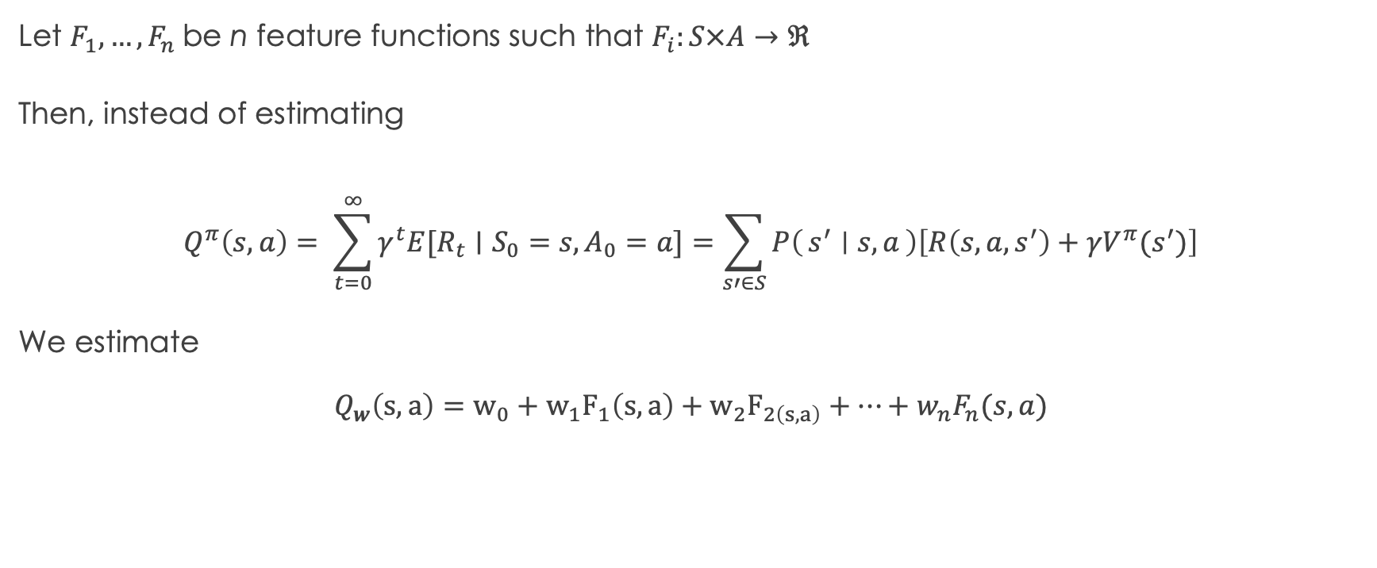
Function approximation: the ML side of RL
Let $F_{1},…, F_{n}$ be n feature functions such that $F_{i}:S×A→ℜ$
Then, instead of estimating
$$Q^{π}\left(s, a\right)= \sum_{t=0}^{∞}{γ^{t}E[R_{t}}∣S_{0}=s, A_{0}=a]=\sum_{s′∈S}{P\left(s^{′} ∣ s, a\right)\left[R\left(s, a, s^{′}\right)+γV^{π}(s^{′})\right]}$$
We estimate
$$Q_{w}\left(s, a\right)=w_{0}+w_{1}F_{1}\left(s, a\right)+w_{2}F_{2\left(s, a\right)}+…+w_{n}F_{n}(s, a)$$

Slide 19
Range of learning approaches
Value-Based Methods
Closely associated with MDP formalism
Requires explicitly representing states
Exact computation with full observability is expensive!
Alternative: function approximation
Policy Search
Idea: optimize with respect to the policy only
No need to estimate the value function!
Requires the policy be differentiable
Does not require the environment be an MDP!
Does not require the environment be stationary

Slide 20
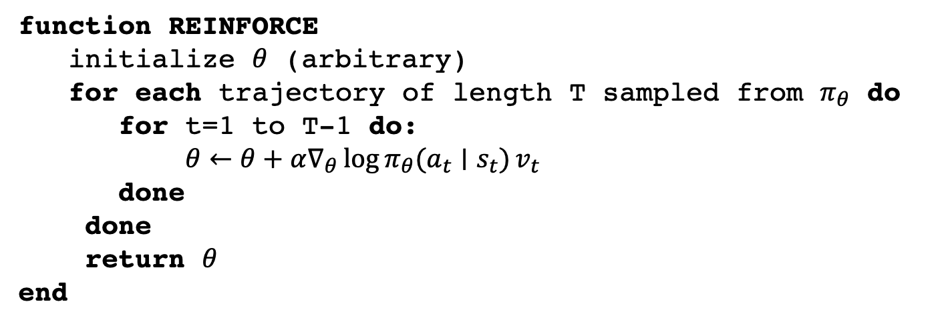
Classical policy search algorithm
function REINFORCE
initialize $θ$ (arbitrary)
for each trajectory of length T sampled from $π_{θ}$ do
for t=1 to T-1 do:
$θ←θ+α∇_{θ}\log{π_{θ}(a_{t}∣s_{t})}v_{t}$
done
done
return $θ$
end
Requires you be able to sample estimates of the value of being in state s at time t

Slide 21
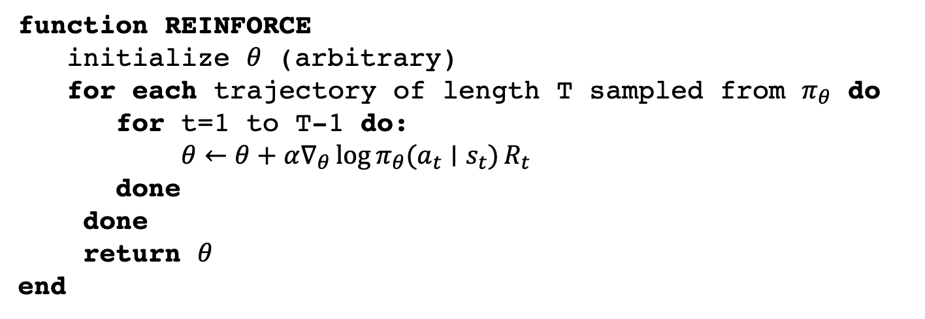
Classical policy search algorithm
function REINFORCE
initialize $θ$ (arbitrary)
for each trajectory of length T sampled from $π_{θ}$ do
for t=1 to T-1 do:
$θ←θ+α∇_{θ}\log{π_{θ}(a_{t}∣s_{t})}R_{t}$
done
done
return $θ$
end
You do this by computing the expected return conditioned on states in this trajectory

Slide 22
Classical policy search algorithm
function REINFORCE
initialize $θ$ (arbitrary)
for each trajectory of length T sampled from $π_{θ}$ do
for t=1 to T-1 do:
$θ←θ+α∇_{θ}\log{π_{θ}(a_{t}∣s_{t})}R_{t}$
done
done
return $θ$
end
Key idea:
Policy distribution is known
Transition probabilities unknown

Slide 23
Range of learning approaches
Value-Based Methods
Closely associated with MDP formalism
Requires explicitly representing states
Exact computation with full observability is expensive!
Alternative: function approximation
Actor-Critic
Policy search + value function estimation!
“Actor” – policy
“Critic” – value function
Value function performs a kind of regularization
Value function encodes domain knowledge about the environment
Policy Search
Idea: optimize with respect to the policy only
Requires the policy be differentiable
Does not require the environment be an MDP!
Does not require the environment be stationary

Slide 24
Problems
MDP/table-based approaches have good theoretical underpinnings
Intractable for large state spaces
Non-toy problems require approximation
Need to encode lots of domain knowledge
Policy gradient methods are performant, especially deep learning-based methods
Poorly understood
Lots of engineering to make sampling work

